Slide 1
Backend - Server Side Scripting
Pravin Y Pawar

Slide 2
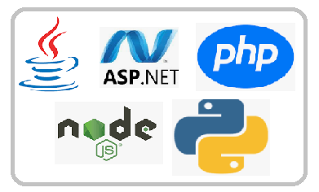
Server Side Scripting
A technique used in web development which involves employing scripts on a web server
which produce a response customized for each user's (client's) request to the website
Scripts can be written in server-side scripting languages
PhP
Python
JSP
ASP .net
Java
Is often used to provide a customized interface for the user
Scripts may assemble client characteristics for use in customizing the response based on those characteristics, the user's requirements, access rights, etc.
Enables the website owner to hide the source code that generates the interface, whereas with client-side scripting, the user has access to all the code received by the client
A down-side to the use of server-side scripting is that the client needs to make further requests over the network to the server in order to show new information to the user via the web browser

Slide 3
Server-side script basics
Runs on a server, embedded in the site’s code
Facilitates the transfer of data from server to browser, bringing pages to life in the browser
Designed to interact with back-end permanent storage, like databases,
Runs on-call. When a webpage is “called up,” or when parts of pages are “posted back” to the server with AJAX, server-side scripts process and return data
Powers functions in dynamic web applications
user validation
saving and retrieving data
navigating between other pages
Build application programming interfaces (APIs)
which control what data and software a site shares with other apps

Slide 4
Popular server-side languages
PHP
The most popular server-side language on the web, PHP is designed to pull and edit information in the database
Most commonly bundled with databases written in the SQL language
PHP-powered sites: WordPress, Wikipedia, Facebook
Python
With fewer lines of code, is fast, making it ideal for getting things to market quickly
Emphasis is on readability and simplicity, which makes it great for beginners
The oldest of the scripting languages, is powerful, and works well in object-oriented designs
Python-powered sites: YouTube, Google, The Washington Post
Ruby
Handles complicated logic on the database side of site vrey well
Great for startups, easy maintenance, and high-traffic demands
Requires developers to use the Ruby on Rails framework, which has vast libraries of code to streamline back-end development
Ruby-powered sites: Hulu, Twitter (originally), Living Social, Basecamp

Slide 5
Popular server-side languages
C#
Language of Microsoft’s .NET Framework—the most popular framework on the web
Combines productivity and versatility by blending the best aspects of the C and C++ languages
Excellent for developing Windows applications, and can be used to build iOS, Android mobile apps with the help of a cross-platform technology like Xamarin
Java
Comes with a huge ecosystem of add-on software components
“Compile once, run anywhere” is its motto
Excellent for enterprise-level applications, high-traffic sites, and Android apps
Java sites: Twitter, Verizon, AT&T, Salesforce

Slide 6
Thank You!
In our next session:

